Slide 1


WELCOME TO JOURNEY-GINIE
GUIDED BY- SMURTI RANJAN NAYAK

Slide 2

OUR JOURNEY submitted By : parthabi maharana(2305260013) pooja Priyadarshini das(23052614)
JOURNRY GINIE

Slide 3


We spent the day rafting down the Colorado River, then spent the night under the stars.
Abstract
Overview – Journey Ginnie is a user-friendly travel booking platform .
Key Features – Trip booking, destination selection, accommodation, and travel partner services.
User Experience – Intuitive UI with a blue-white theme, animations, and seamless navigation .
Admin Dashboard – Manages bookings, payments, and reviews efficiently .
Security & Tech – Secure registration, Aadhaar verification, and smooth payments using HTML, CSS, and JS .
Goal – Simplifying travel with a smart, secure, and engaging platform.

Slide 4

“The mountains are calling – and I must go.” John Muir
Introduction
JOURNEY GINIE
About Journey Ginnie – A modern travel booking platform designed for seamless trip planning and hassle-free experiences.
Core Services – Offers trip booking, destination selection, accommodation, and travel partner options.
User-Friendly Interface – Intuitive design with a visually appealing blue-white theme and smooth navigation.
Admin & Management – Efficient dashboard for managing destinations, bookings, payments, and reviews.
Security & Innovation – Secure registration with Aadhaar verification, budget planning, and integrated payment solutions.

Slide 5



We hiked over 50 miles this trip and drove nearly 2,000 to reach our destination.
KEY OBJECTIVE 3
KEY OBJECTIVE 1
KEY OBJECTIVE 2
Ensure Security & Convenience – Implement secure registration, Aadhaar verification, and hassle-free payments.
Simplify Travel Planning – Provide an easy-to-use platform for seamless trip booking and management.
Enhance User Experience – Offer an intuitive, visually appealing interface with smooth navigation.

Slide 6


PURPOSE OF JOURNEY GINIE
Seamless Travel Planning & Booking Journey Ginnie aims to provide a comprehensive platform where users can effortlessly book trips, accommodations, and transportation, ensuring a hassle-free travel experience.
Personalized & Budget-Friendly Travel Solutions – The platform enables users to tailor their travel plans by selecting destinations, setting budgets, and customizing itineraries to align with their preferences and financial considerations.
Efficient Travel Management & Administration – Journey Ginnie offers an advanced admin dashboard to streamline destination management, booking processes, payment tracking, and customer engagement, ensuring a smooth operational workflow.

Slide 7
Scope OF JOUNEY GINIE
Comprehensive Travel Booking – Seamless trip, accommodation, and transportation booking.
Personalized Travel Experience – Customizable trips with budget and destination preferences.
User & Admin Management – Secure registration, Aadhaar verification, and an advanced admin dashboard.
Secure Payment System – Smooth transactions with multiple payment options.
Destination & Accommodation Services – Easy access to hotels, restaurants, and travel offers.
Interactive & Engaging UI – Visually appealing design with animations and a user-friendly experience.

Slide 8

Tool for development
Software:
Frontend: HTML, CSS, JavaScript (Bootstrap, Tailwind)
Backend: PHP, Node.js, or Python (Django/Flask)
Database: MySQL, PostgreSQL, or MongoDB
Payment: Razorpay, PayPal, Stripe
Admin Dashboard: React, Angular, or Vue.js
Hosting: AWS, Firebase, or Netlify
Design: Figma, Adobe XD, Canva
Hardware:
Server: Cloud hosting (AWS, Google Cloud) with 8GB RAM, 100GB SSD
Development: PC/Laptop (8GB RAM, i5/i7 Processor)
User Devices: Smartphones, tablets, desktops (responsive design)

Slide 9

goals
Comprehensive Travel Solutions – Establish an integrated platform for seamless trip, accommodation, and transportation bookings.
Personalized & Data-Driven Experiences – Enhance user engagement through tailored travel recommendations based on preferences and budget.
Optimized Administrative Efficiency – Streamline destination management, bookings, payments, and user interactions with an intuitive admin dashboard.
Secure & Scalable Digital Infrastructure – Ensure robust security, seamless transactions, and a visually engaging, user-friendly interface for a superior travel experience.

Slide 10
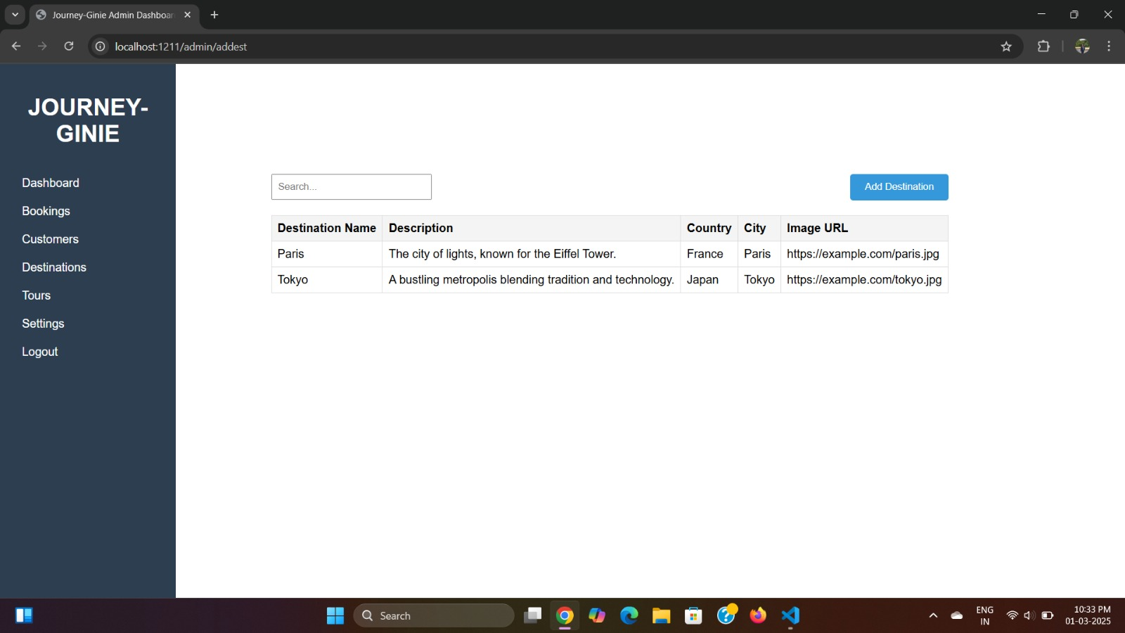
Admin dashboard of jouney-ginie

Slide 11
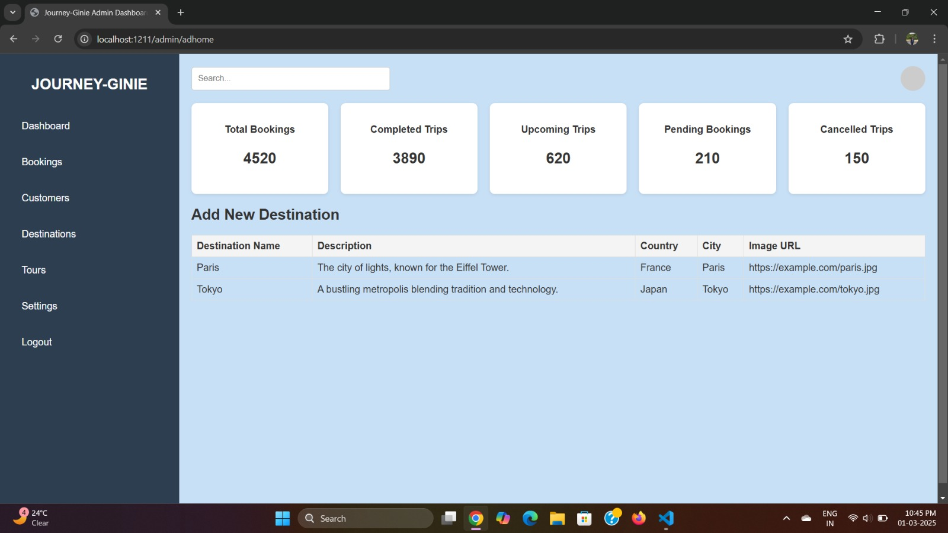
Home page of admin dashboard

Slide 12
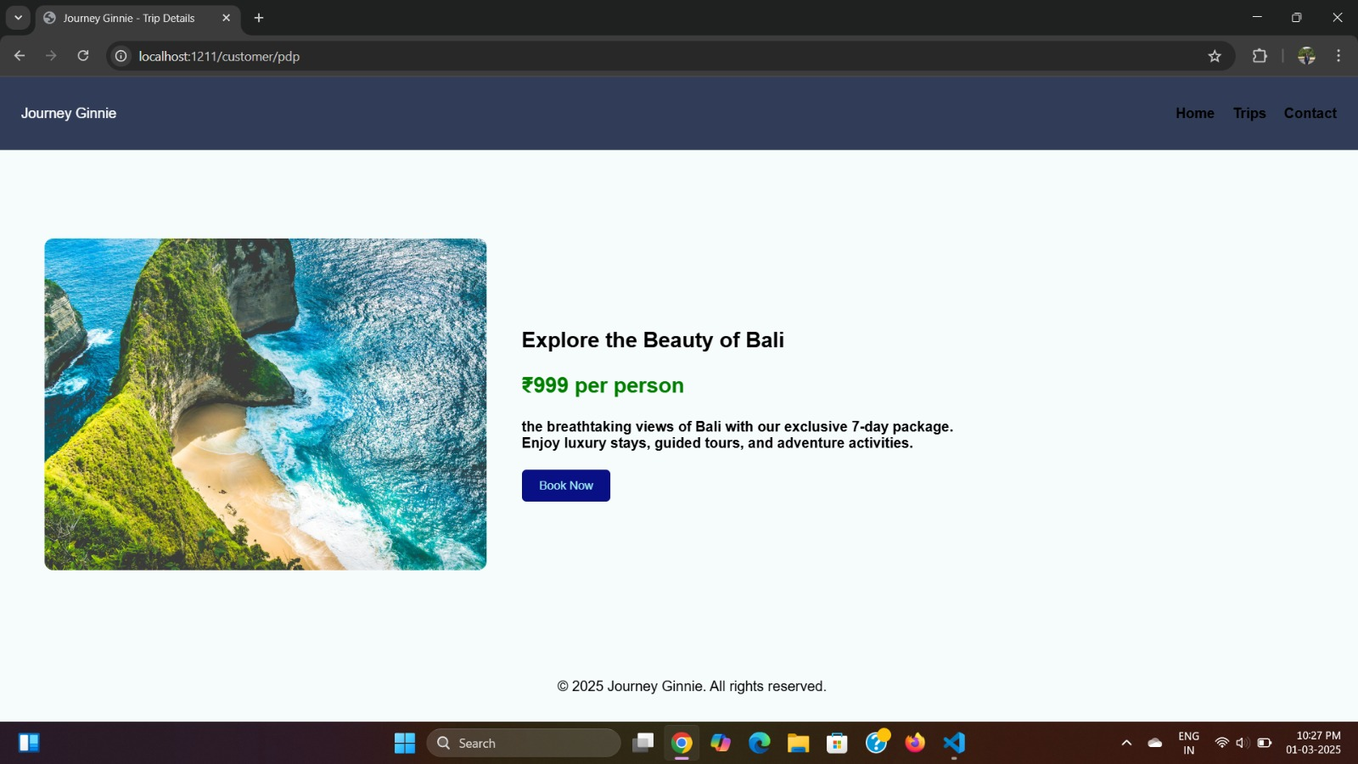
Pdp page of journey-ginie

Slide 13
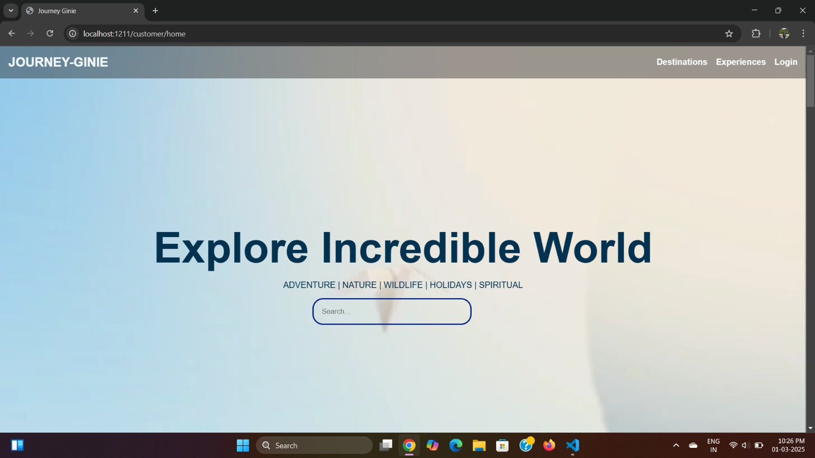
Home page of journey-ginie

Slide 14
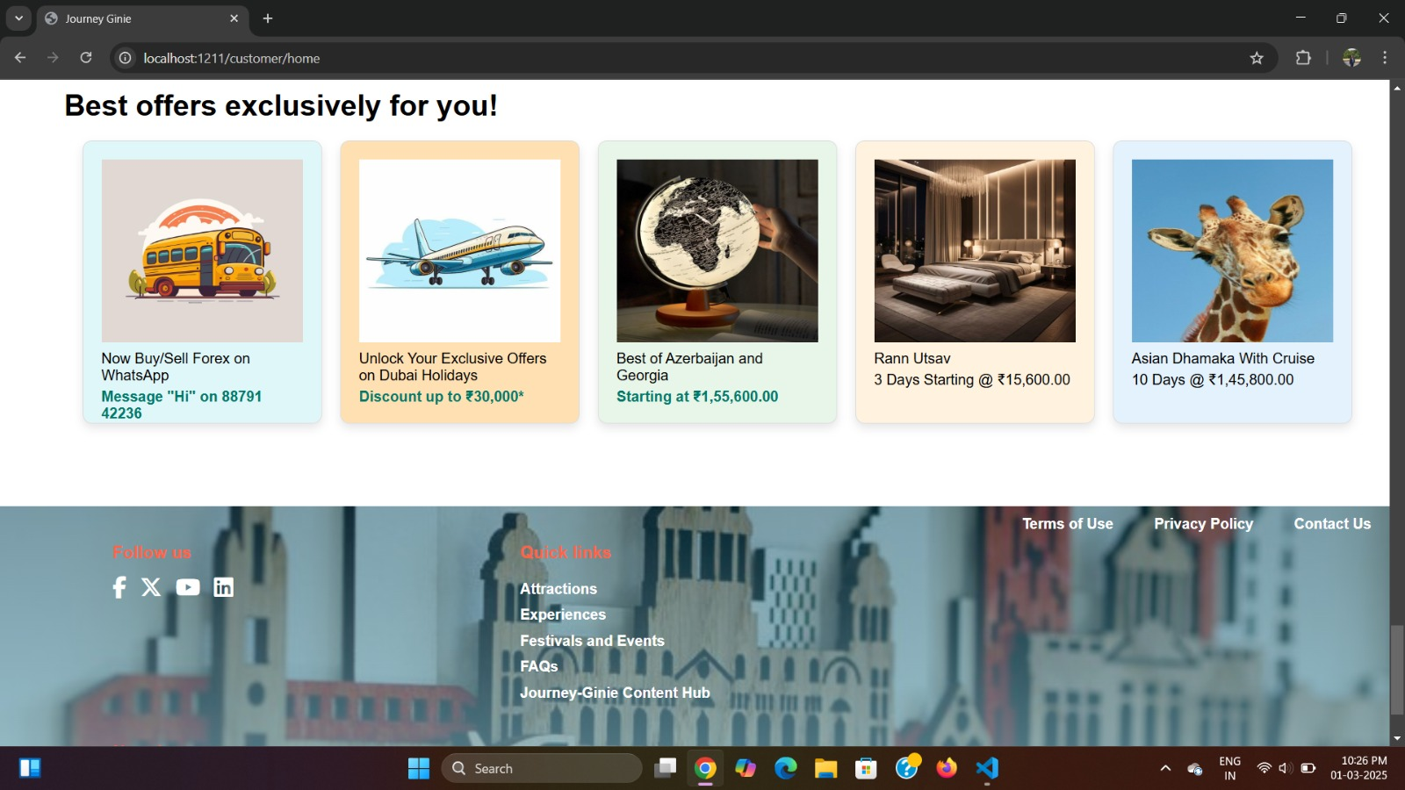
Footer of journey-ginie

Slide 15
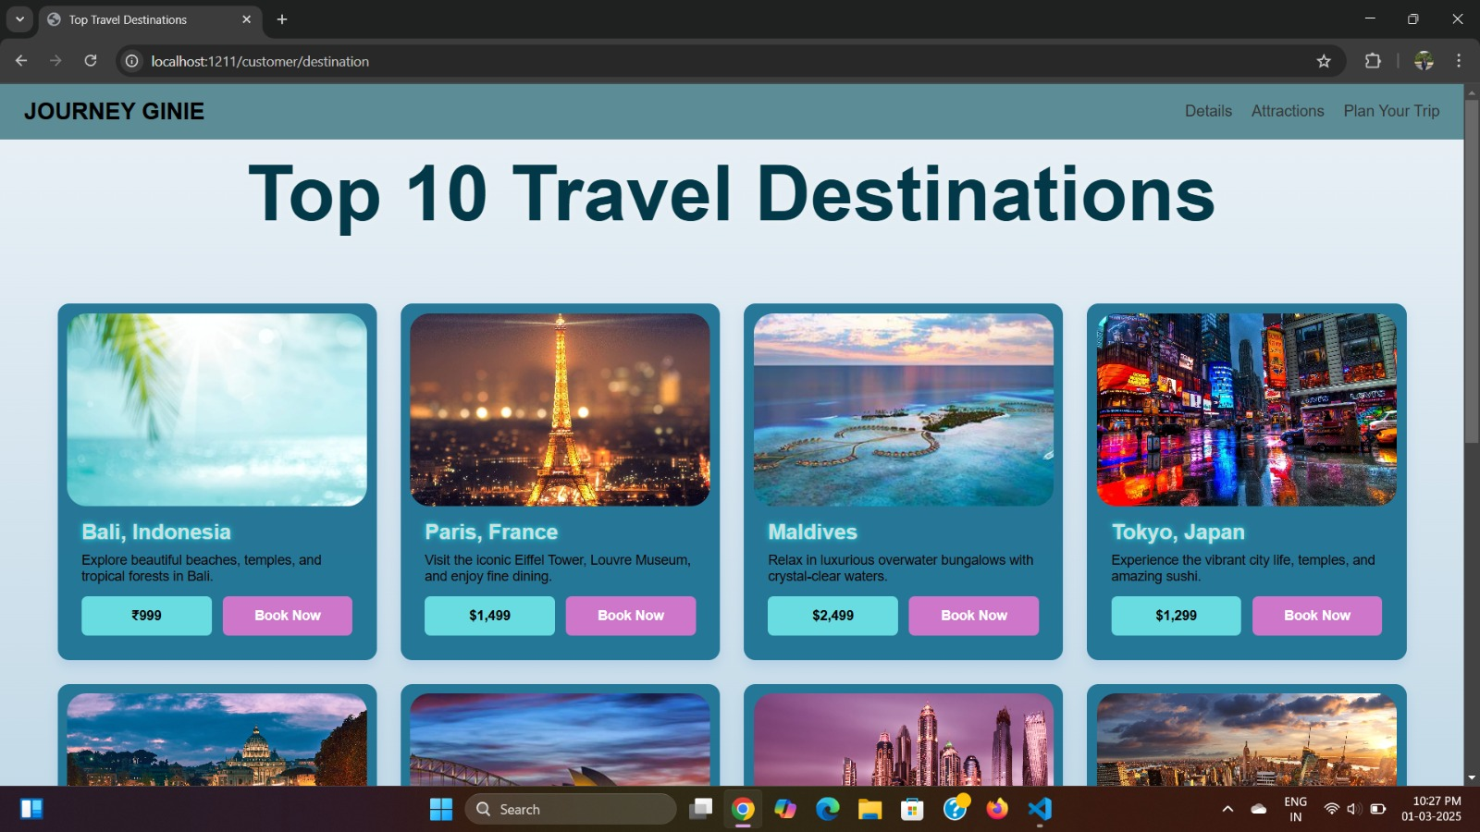
Plp page of our website

Slide 16
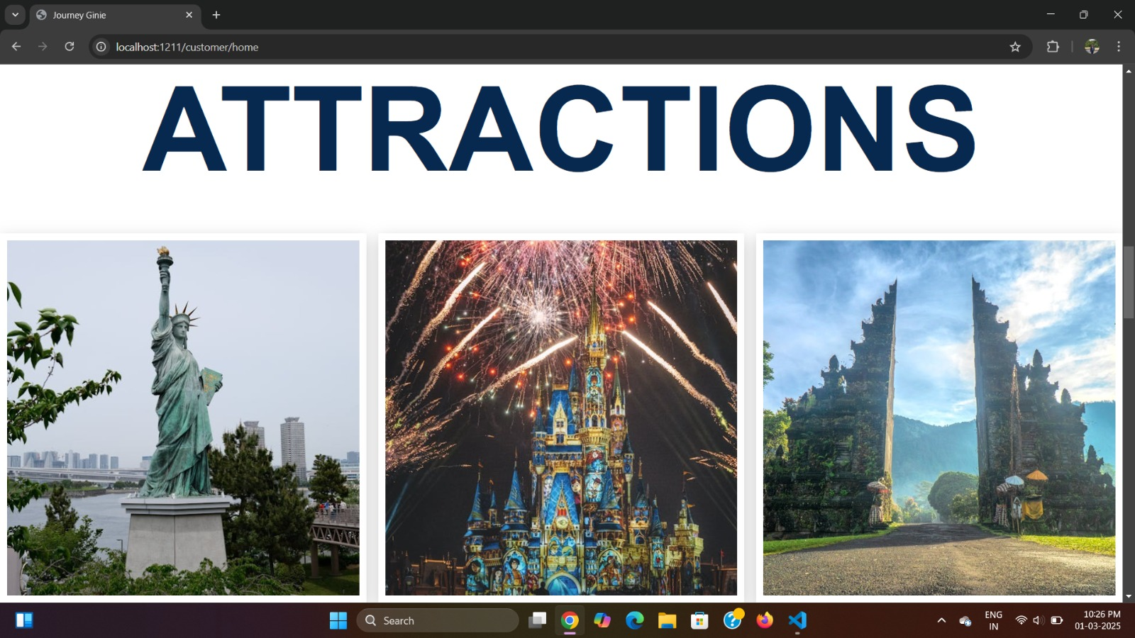
Attraction page of our website

Slide 17
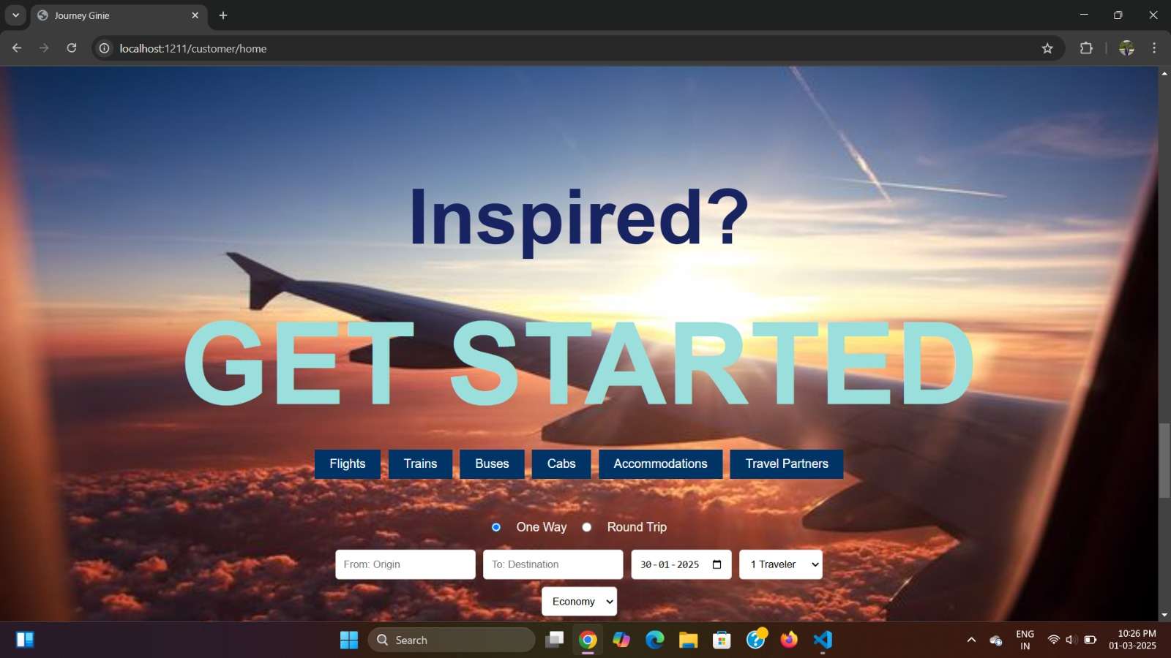
Inspired enough?

Slide 18
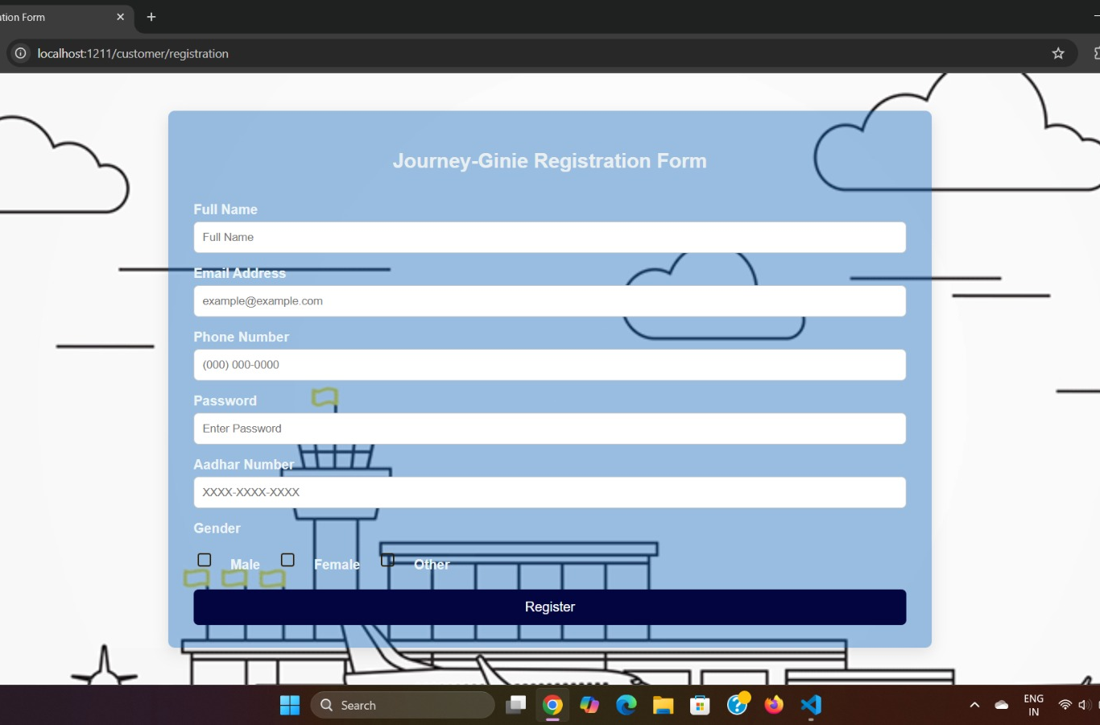
Welcome to our website!!

Slide 19
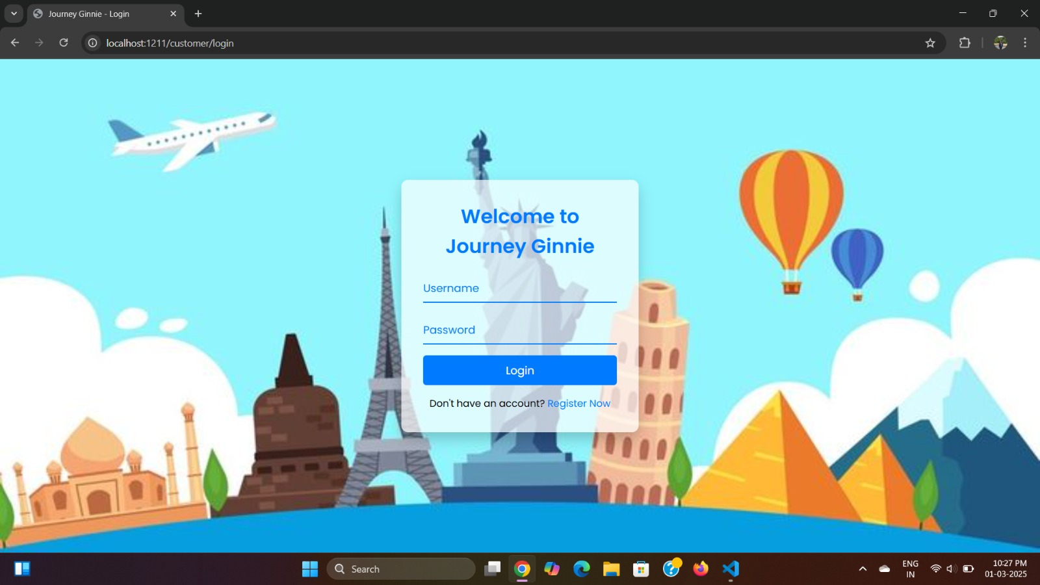
Please login to our website!!

Slide 20

conclusion
Journey Ginnie is a comprehensive travel platform designed to simplify trip planning, enhance user experience, and streamline travel management. With seamless booking options, personalized travel solutions, and a secure payment system, it ensures a hassle-free journey for travelers. The platform’s intuitive admin dashboard optimizes destination and booking management, making operations efficient. Combining innovation, security, and a visually engaging interface, Journey Ginnie aims to redefine modern travel experiences.

Slide 21

Thank you!!

Slide 22

Slide title 7

Slide 23
ESCAPE
the great

